Slide 1

Interaction – Part 2
Nina Gunnes
April 22, 2021

Slide 2
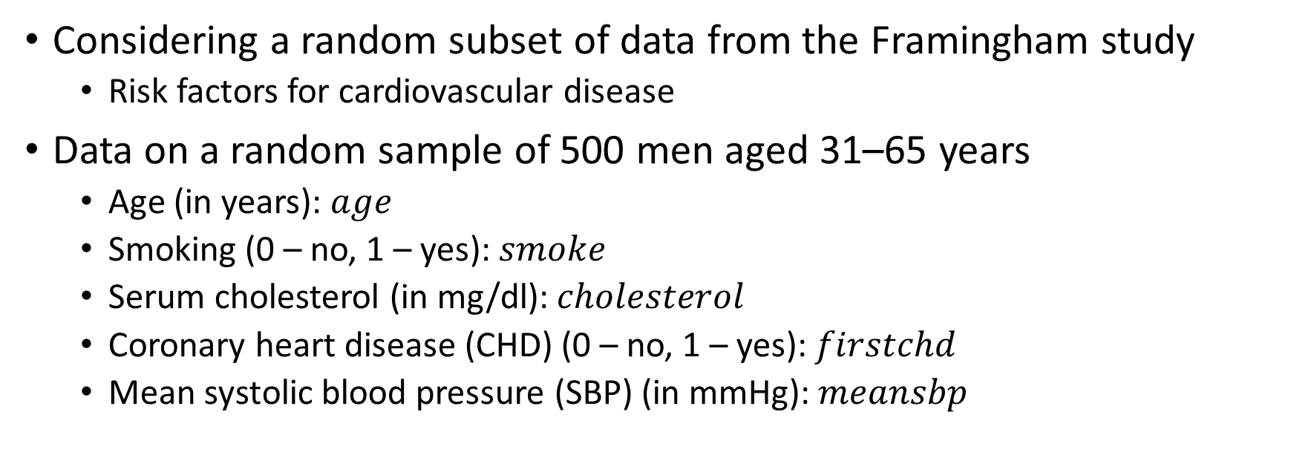
Data on coronary heart disease
Considering a random subset of data from the Framingham study
  Risk factors for cardiovascular disease
Data on a random sample of 500 men aged 31–65 years
  Age (in years): $age$
  Smoking (0 – no, 1 – yes): $smoke$
  Serum cholesterol (in mg/dl): $cholesterol$
  Coronary heart disease (CHD) (0 – no, 1 – yes): $firstchd$
  Mean systolic blood pressure (SBP) (in mmHg): $meansbp$

Slide 3
Data on coronary heart disease, cont.
Described in Chapter 3 in the book by Laake et al. (2007)
Data and variable description available for download
  https://carroll.stat.tamu.edu/data-sets/
  https://www.med.uio.no/imb/personer/vit/veierod/boker/epidemiologiske-og-kliniske-forskningsmetoder/datafiler/
Inspecting the data
  Summary of data set and values of variables
  Frequency counts and summary statistics

Slide 4
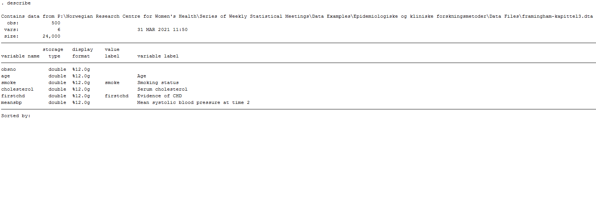
Data on coronary heart disease, cont.

Slide 5
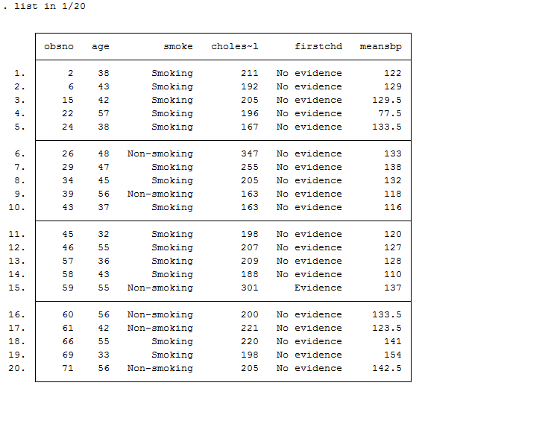
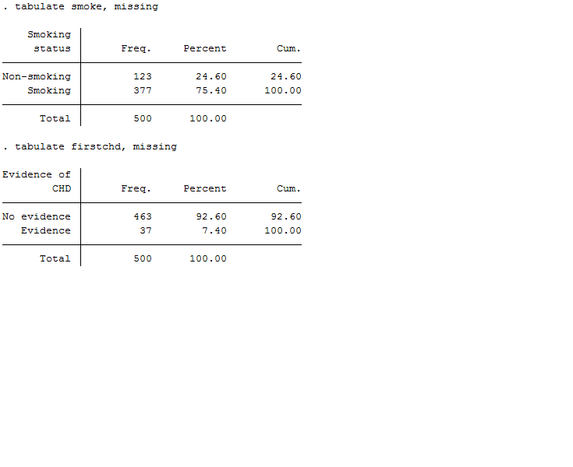
Data on coronary heart disease, cont.

Slide 6
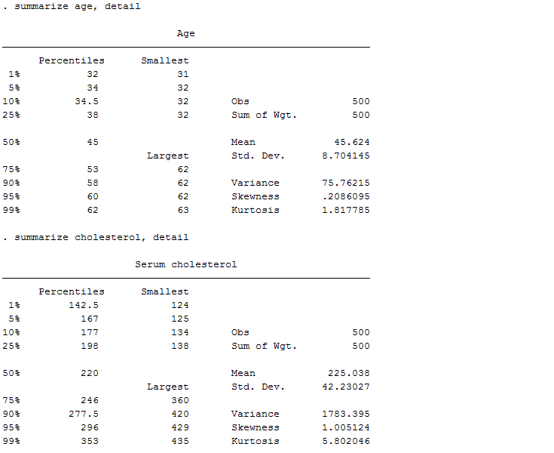
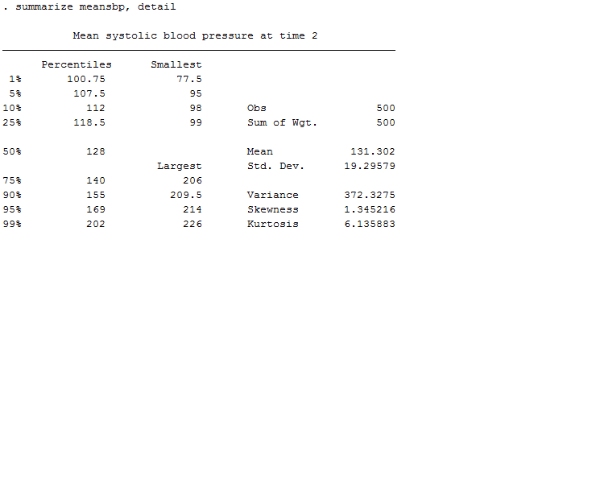
Data on coronary heart disease, cont.

Slide 7
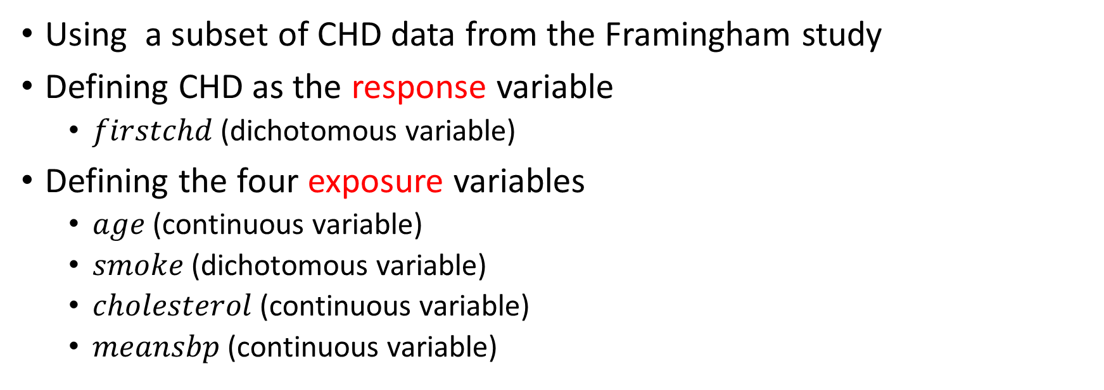
Interaction in logistic regression
Using a subset of CHD data from the Framingham study
Defining CHD as the response variable
  $firstchd$ (dichotomous variable)
Defining the four exposure variables
  $age$ (continuous variable)
  $smoke$ (dichotomous variable)
  $cholesterol$ (continuous variable)
  $meansbp$ (continuous variable)

Slide 8
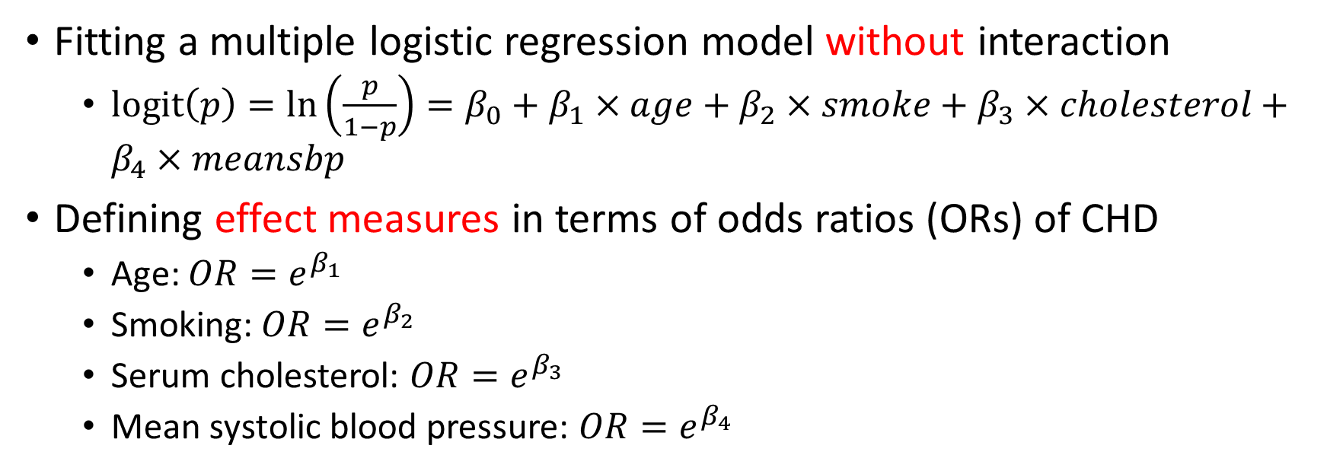
Interaction in logistic regression, cont.
Fitting a multiple logistic regression model without interaction
  $\text{logit}\left(p\right)=\ln\left(\frac{p}{1−p}\right)=β_{0}+β_{1}×age+β_{2}×smoke+β_{3}×cholesterol+β_{4}×meansbp$
Defining effect measures in terms of odds ratios (ORs) of CHD
  Age: $OR=e^{β_{1}}$
  Smoking: $OR=e^{β_{2}}$
  Serum cholesterol: $OR=e^{β_{3}}$
  Mean systolic blood pressure: $OR=e^{β_{4}}$

Slide 9
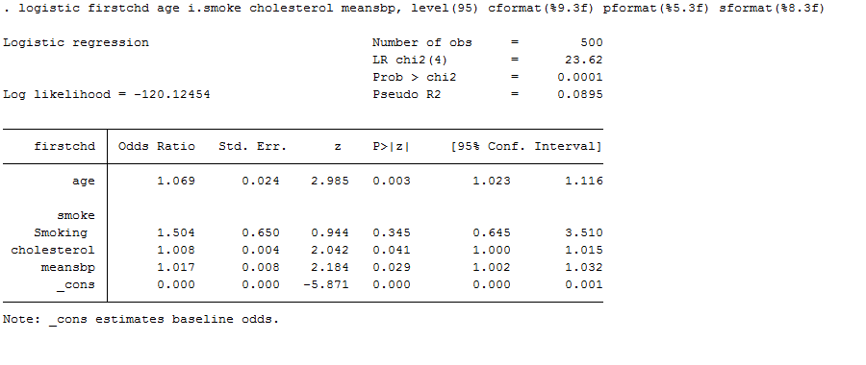
Interaction in logistic regression, cont.

Slide 10
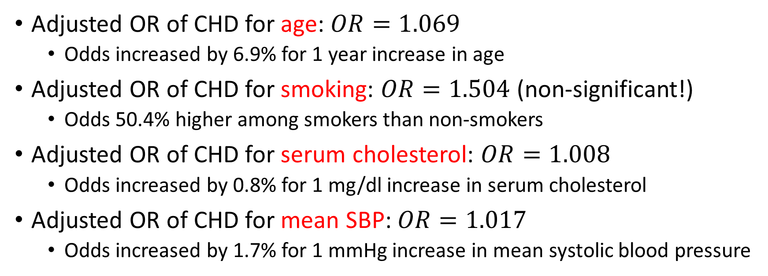
Interaction in logistic regression, cont.
Adjusted OR of CHD for age: $OR=1.069$
  Odds increased by 6.9% for 1 year increase in age
Adjusted OR of CHD for smoking: $OR=1.504$ (non-significant!)
  Odds 50.4% higher among smokers than non-smokers
Adjusted OR of CHD for serum cholesterol: $OR=1.008$
  Odds increased by 0.8% for 1 mg/dl increase in serum cholesterol
Adjusted OR of CHD for mean SBP: $OR=1.017$
  Odds increased by 1.7% for 1 mmHg increase in mean systolic blood pressure

Slide 11
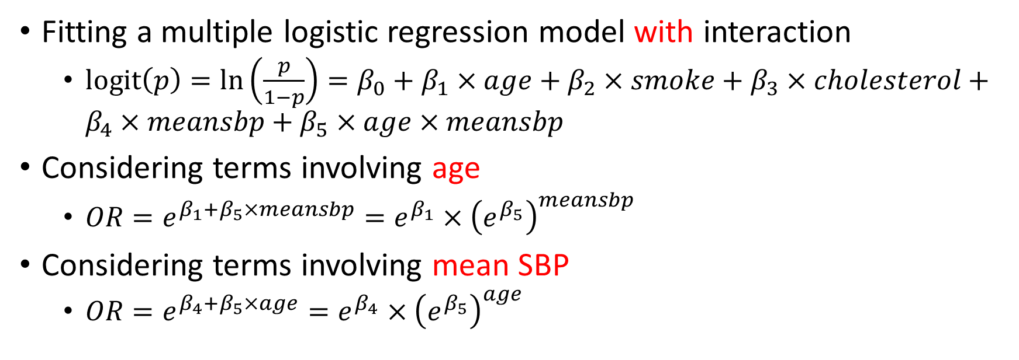
Interaction in logistic regression, cont.
Fitting a multiple logistic regression model with interaction
  $\text{logit}\left(p\right)=\ln\left(\frac{p}{1−p}\right)=β_{0}+β_{1}×age+β_{2}×smoke+β_{3}×cholesterol+β_{4}×meansbp+β_{5}×age×meansbp$
Considering terms involving age
  $OR=e^{β_{1}+β_{5}×meansbp}=e^{β_{1}}×{\left(e^{β_{5}}\right)}^{meansbp}$
Considering terms involving mean SBP
  $OR=e^{β_{4}+β_{5}×age}=e^{β_{4}}×{\left(e^{β_{5}}\right)}^{age}$

Slide 12
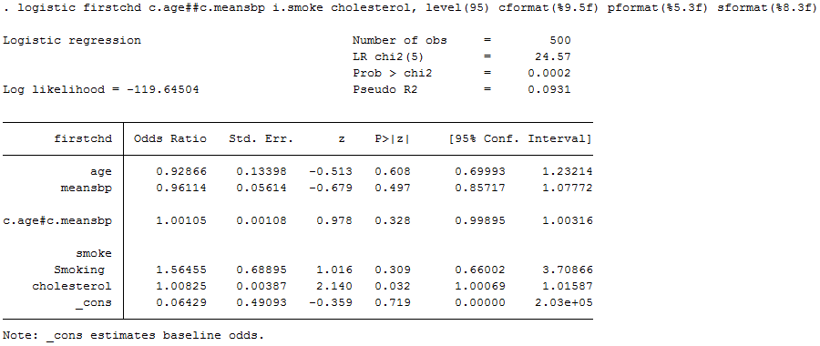
Interaction in logistic regression, cont.

Slide 13
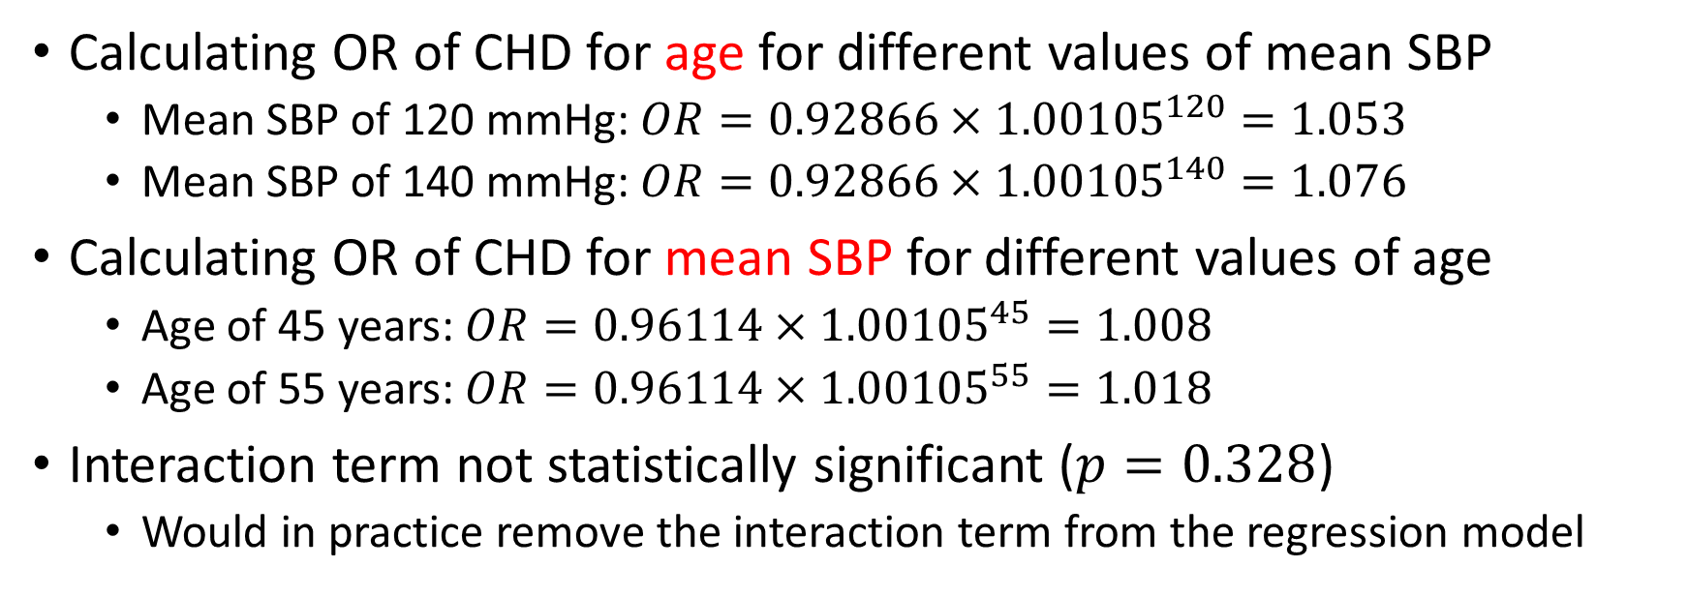
Interaction in logistic regression, cont.
Calculating OR of CHD for age for different values of mean SBP
  Mean SBP of 120 mmHg: $OR=0.92866×{1.00105}^{120}=1.053$
  Mean SBP of 140 mmHg: $OR=0.92866×{1.00105}^{140}=1.076$
Calculating OR of CHD for mean SBP for different values of age
  Age of 45 years: $OR=0.96114×{1.00105}^{45}=1.008$
  Age of 55 years: $OR=0.96114×{1.00105}^{55}=1.018$
Interaction term not statistically significant ($p=0.328$)
  Would in practice remove the interaction term from the regression model

Slide 14
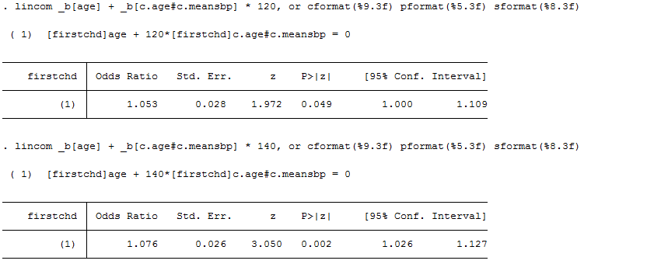
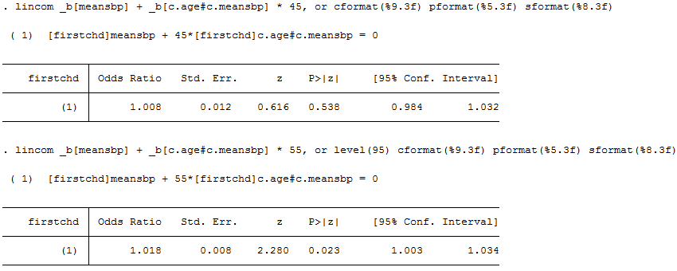
Interaction in logistic regression, cont.

Slide 15
References
Laake P, Hjartåker A, Thelle DS, Veierød MB. Epidemiologiske og kliniske forskningsmetoder. Oslo: Gyldendal akademisk; 2007. https://www.med.uio.no/imb/forskning/publikasjoner/boker/2007/epidemiolgiske-kliniske-forskningsmetoder.html.
StataCorp. 2017. Stata 15 Base Reference Manual. College Station, TX: Stata Press.

